Slide 1
Cost-Effective Food Monitoring
Travis Wright
Computer Science

Slide 2
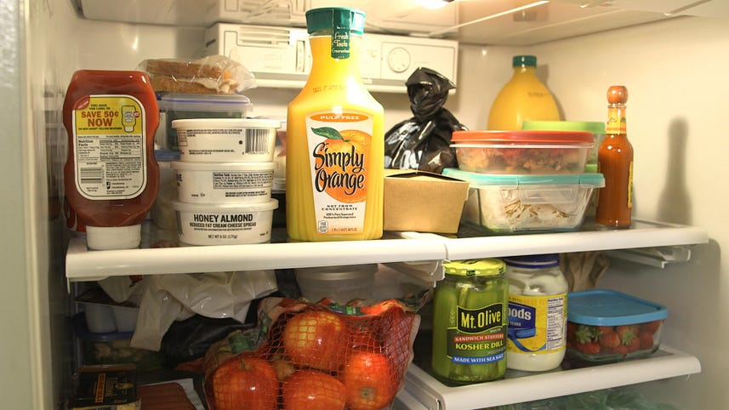
Problem
Foods expiring before individuals have a chance to consume them.
Expirations dates might come and go without the consumer realizing it (e.g. foods in the back of the fridge)
The average family of four spends $1500 per year on food that does not get eaten
Consumers keep buying different product, and neglect to consume or cook with ingredients that are nearing their expiration dates
Expiration dates on many food packaging are often hard to find, tiny writings stamped on packaging.
A user must physically look for the expiration date

Slide 3
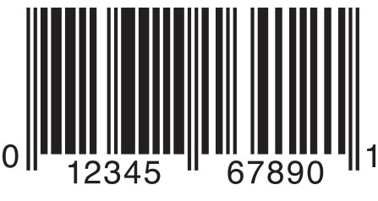
How are food items identified today?
Grocery stores in the US primarily use the UPC-A barcode format to scan and inventory items
Consists of:
1 digit classification code (product, drugs, coupons, etc.)
5 digit manufacturer identifier
5 digit product identifier
1 digit check value
Simple, relatively small number, that can be easily put on smaller packages, and scanned with inexpensive barcode scanners and smartphones

Slide 4
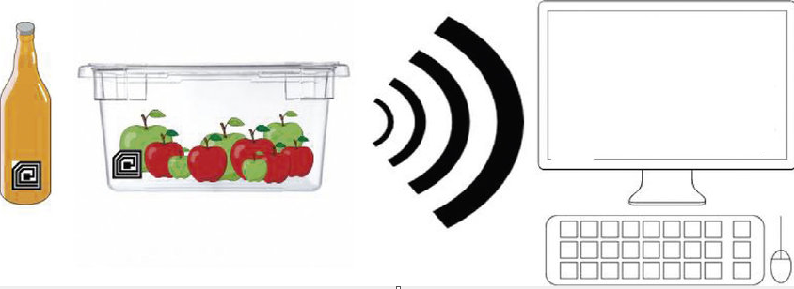
RFID Communication
Radio Frequency Identification
Communication over UHF (ultra-high frequency)
Short-range scanning in a proximity environment
No battery required in RFID tags
Tags boards can be used within stickers
Originally considered NFC, but switched to RFID due to greater flexibility and ease-of-use

Slide 5
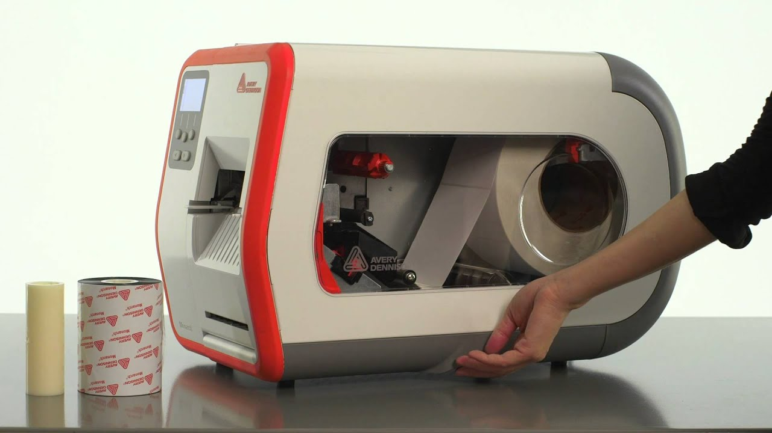
Method for writing RFID Tags
Avery Monarch Label Printer
Prints labels, and encodes RFID data simultaneously
Very fast – useful for a commercial setting (batch jobs)
Batch jobs typically used for printing hundreds of RFID-enabled tags within a short time
Utilized 96-bit tags – typically just used for encoding item identifier and other basic data
EPC (Electronic Product Code) Gen 2 tags can hold up to 512 bits of data

Slide 6
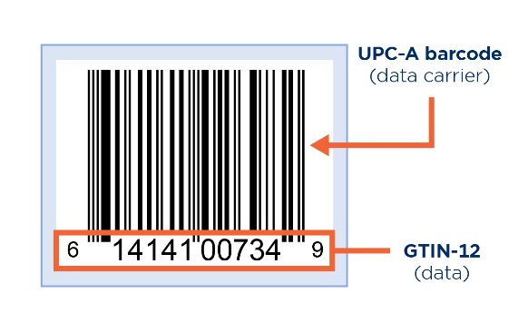
Encoding data into RFID tags
Due to space limitations of my tags (96-bits), I limited the tags to hold GTIN, and expiration date
GTIN is an item identifier, which can be used in conjunction with a UPC-A barcode
For this project, I utilized SGTIN+ format (serial GTIN +)
GTIN was taken directly from the barcode
Expiration date was used in serial number field, due to 96-bit limitation on RFID tag

Slide 7
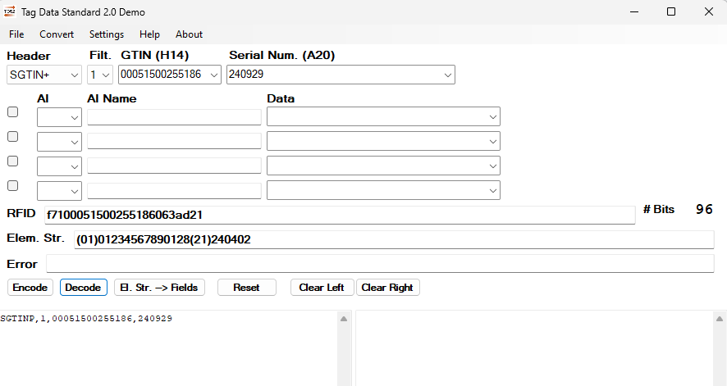
Avery Tag Data Standard

Slide 8
Avery Tag Data Standard

Slide 9
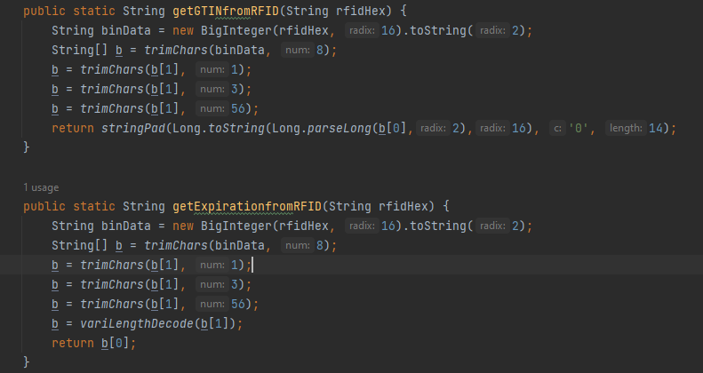
Adapting the app to Java code
Converting hexadecimal RFID data into a plain text GTIN and expiration date (YYMMDD)
Trimming down the hexadecimal string until the desired value is obtained
The Avery software utilizes different headers, check bits, etc. that are trimmed out to be ignored
Based on code from WSU 2023 Hackathon utilizing RFID formats, however, I reversed the code to encode data into RFID as well as decode

Slide 10
The Idea
Android app where consumers can add item, view data, and be notified of expiring foods.
Central interface with RFID, that keeps track of items within fridge, as well as temperature/humidity
User can also add items from phone, or have the central interface add them automatically.
Originally started project with NFC, but realized how RFID has a higher ease of use
From the average person’s perspective, manually adding each item for expiration notifications takes too much time
For my project, interface is laptop-based, but in final product, it could be a Raspberry Pi, or small ARM-based microcomputer

Slide 11
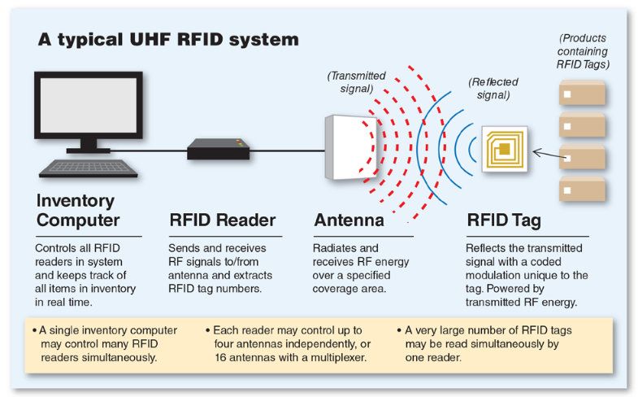
How is RFID used in commercial settings?

Slide 12
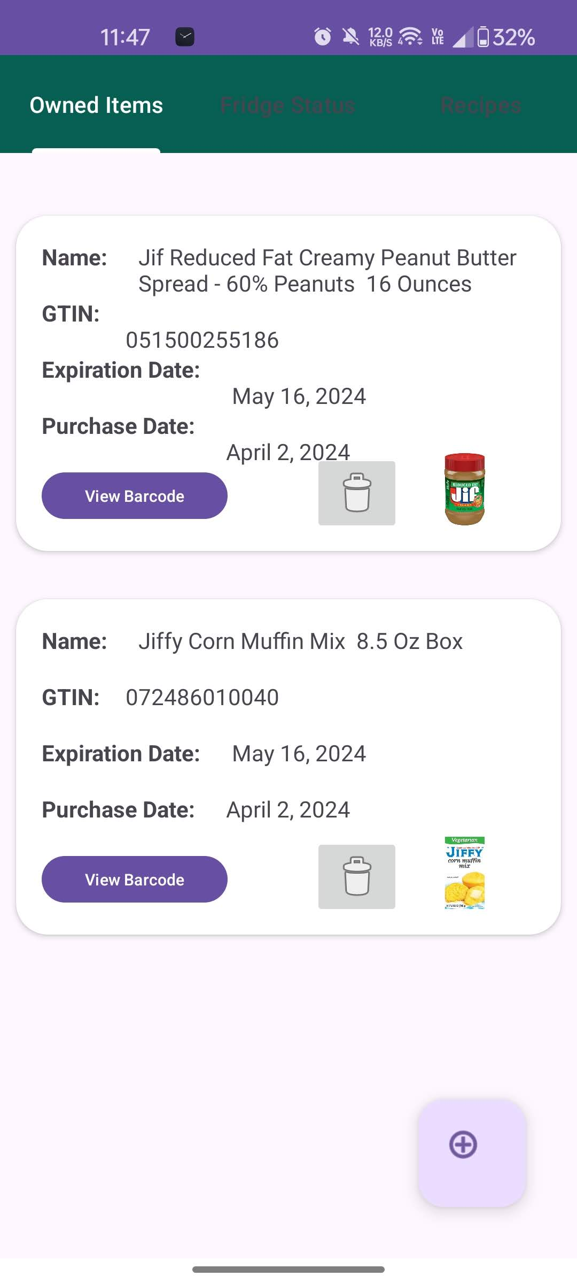
The Android App
Built using Android Studio
Java (Why not Kotlin?)
List of currently owned food items, with expiration dates
Notifications for high fridge temperatures, and expiring foods
AI-Generated list of recipes
Sign-In for different users using the app
Utilizing Firebase for item storage – real-time database, updating constantly

Slide 13
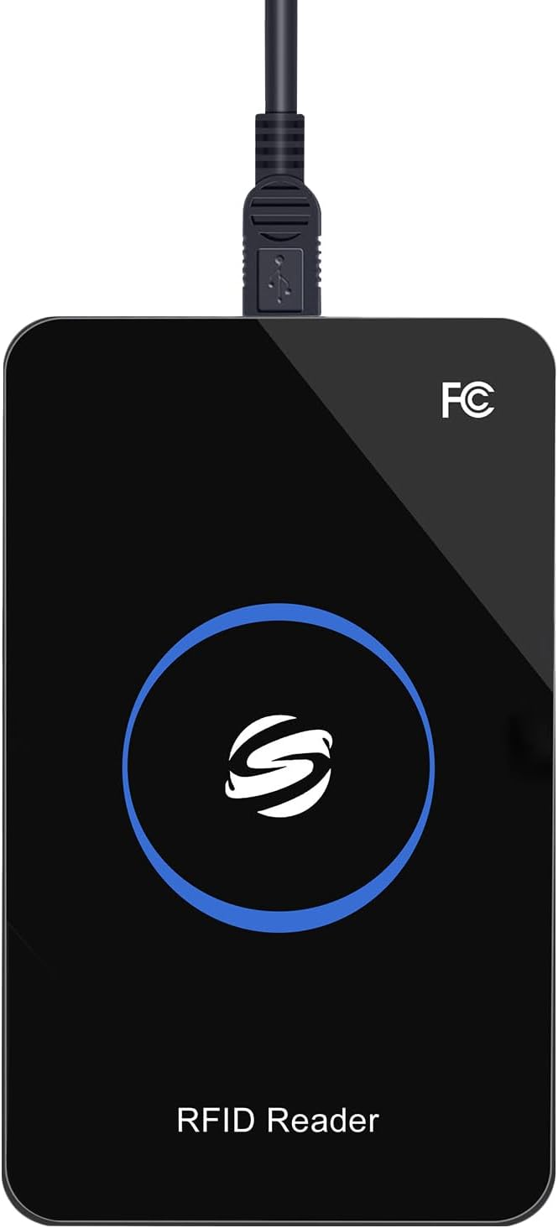
Computer Interface
Java code running on a Windows laptop
Reads serial data from DHT11
Reads keyboard input from RFID reader
Adds data to Firebase
Reads input continuously
Sets up email expiration reminders 7 days before expiration date, using Java Timer task system, and Gmail SMTP server

Slide 14
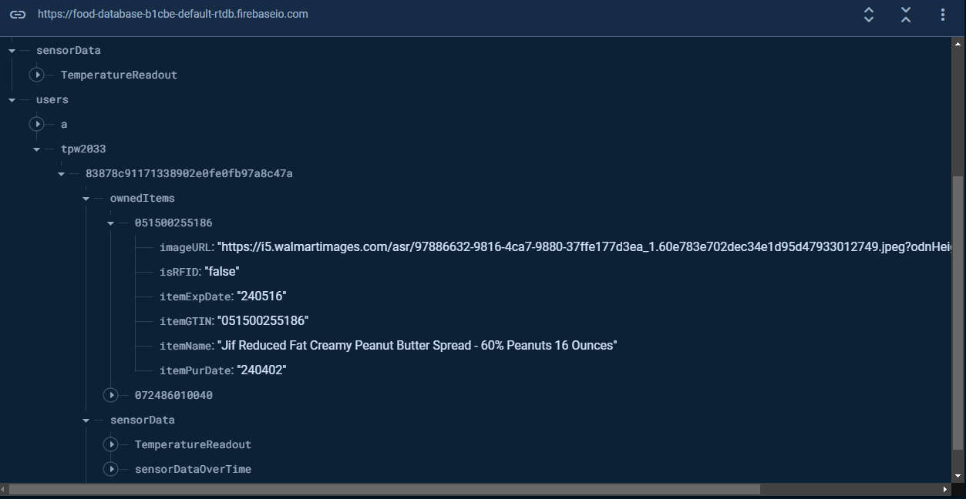
Firebase Real-Time Database
A Google product (integrates well with Android)
Utilizing value “listeners” to update item list, temperature values, etc. in real time
Free to use
Storing temperature data for time-based graph
Storing owned items with following details:
Image URL
isRFID or not
Expiration
GTIN
Item Name
Purchase Date
Based on the GTIN/UPC, a lookup API is utilized to grab item name and an associated image

Slide 15
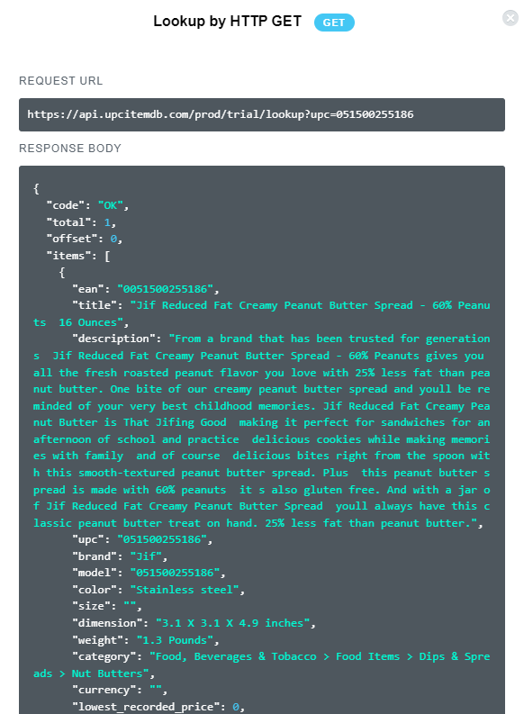
UPC Lookup API
Utilizes UPC-A barcode
Lookup item name, description, and other details
In my project, grabbing Walmart item name, as well as Walmart image URL
What about other grocery store’s product?
API is easy to implement using OkHTTP Java client
Call request with UPC
Grab Walmart image URL and title, and use that in app

Slide 16
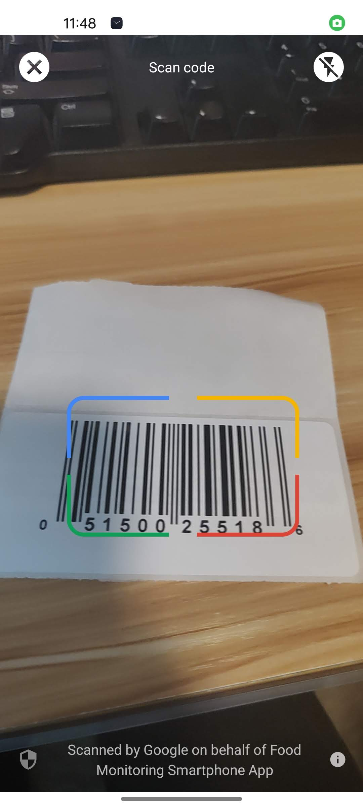
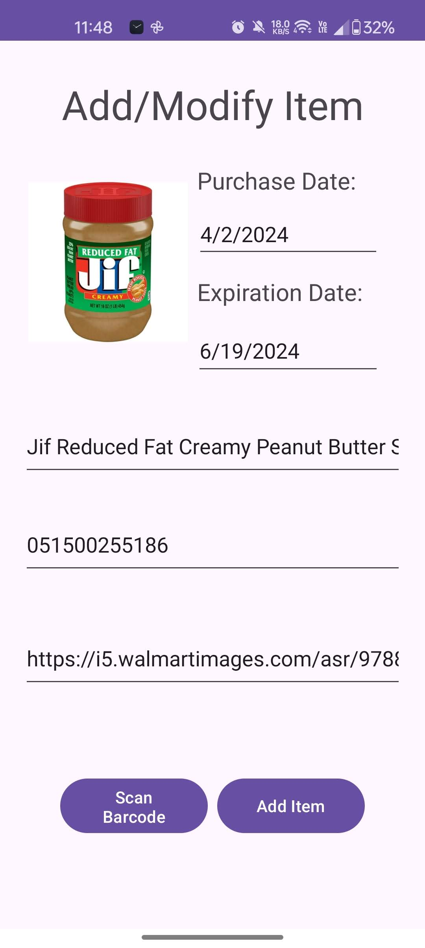
Adding Items to the App
Scan UPC-A barcode utilizing phone
Another approach to adding an item
UPC API automatically fills in name and image representing item
GmsBarcodeScanner used to scan barcode
Only about 4 lines of code to use this external barcode-scanning tool
User manually enters expiration date, and can change purchase date as necessary

Slide 17
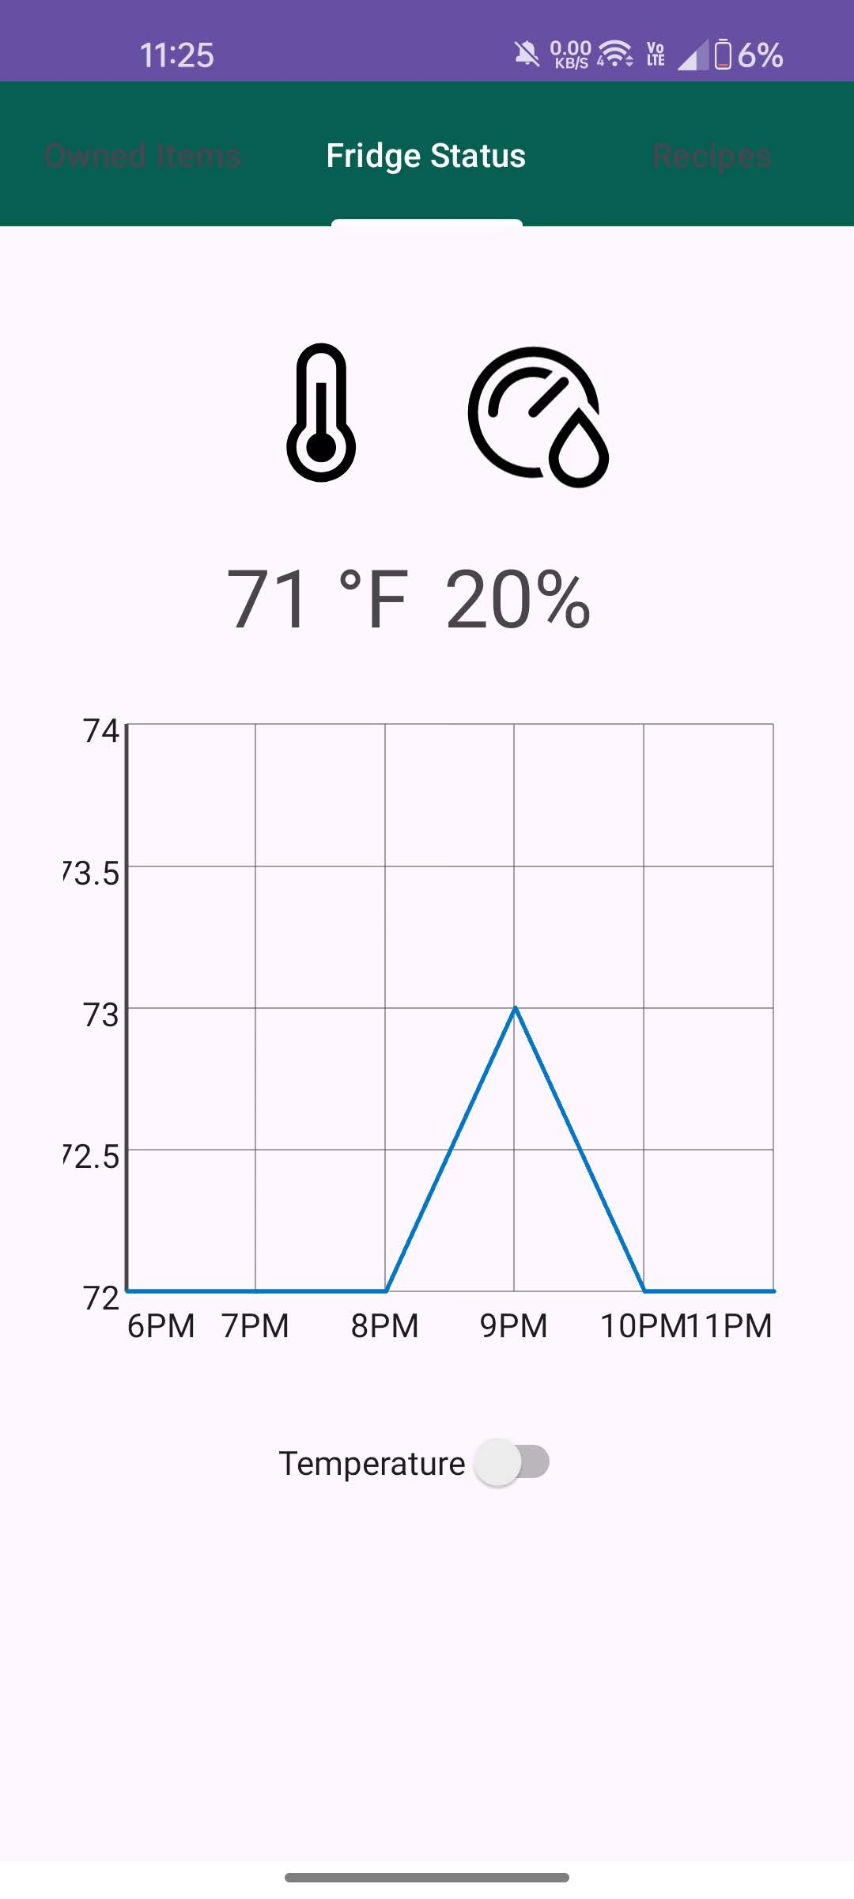
Fridge Monitoring
Live view of fridge temperature and humidity
Utilizing Arduino Nano, and DHT11 temperature/humidity sensor
Serial communication over USB communicated with the laptop, to update the temperature in real time
Graph shows the last 5 hours of temperature/humidity changes
Helps to prevent food spoiling, or could be used with backup power for monitoring
Pros and Cons of the DHT11 sensor

Slide 18
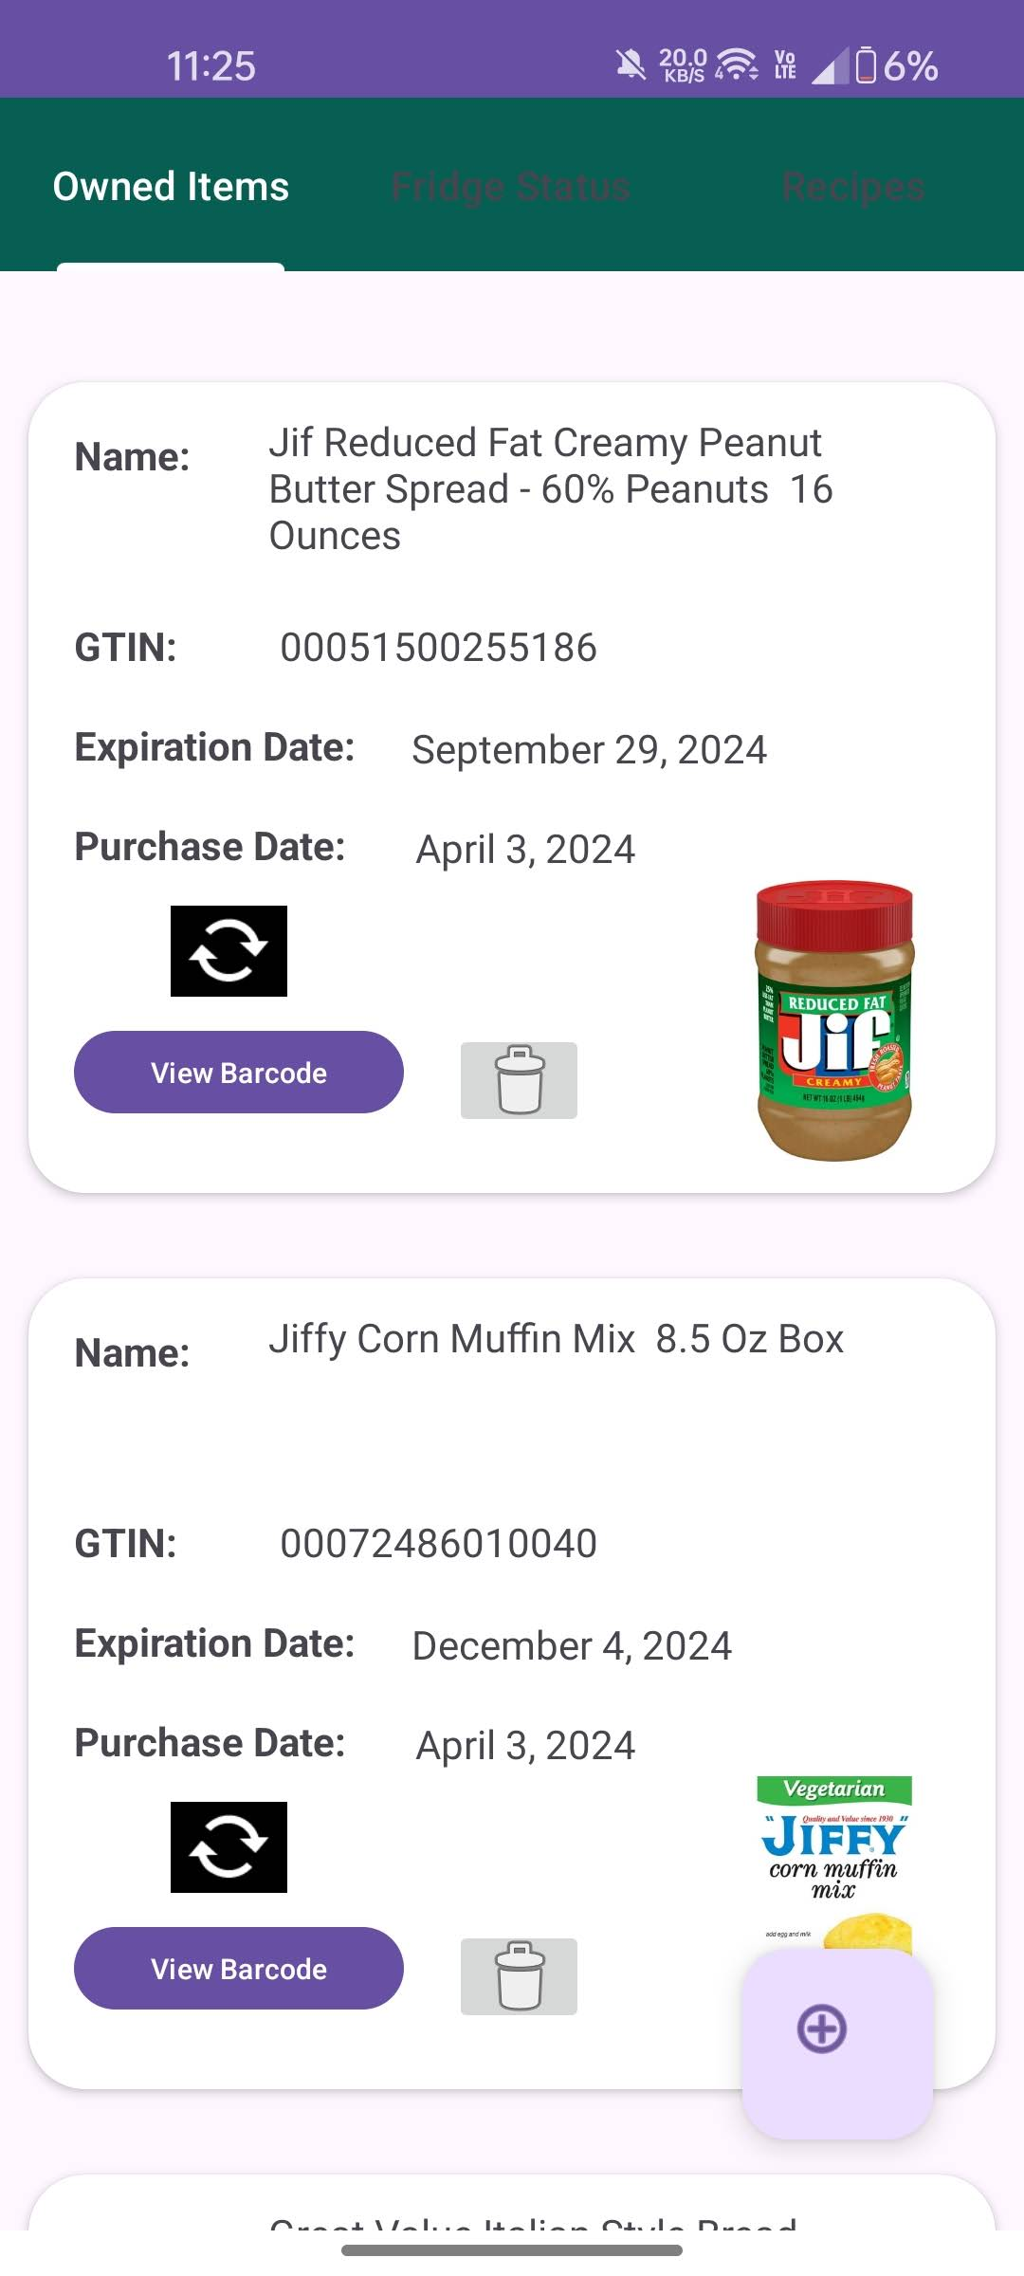
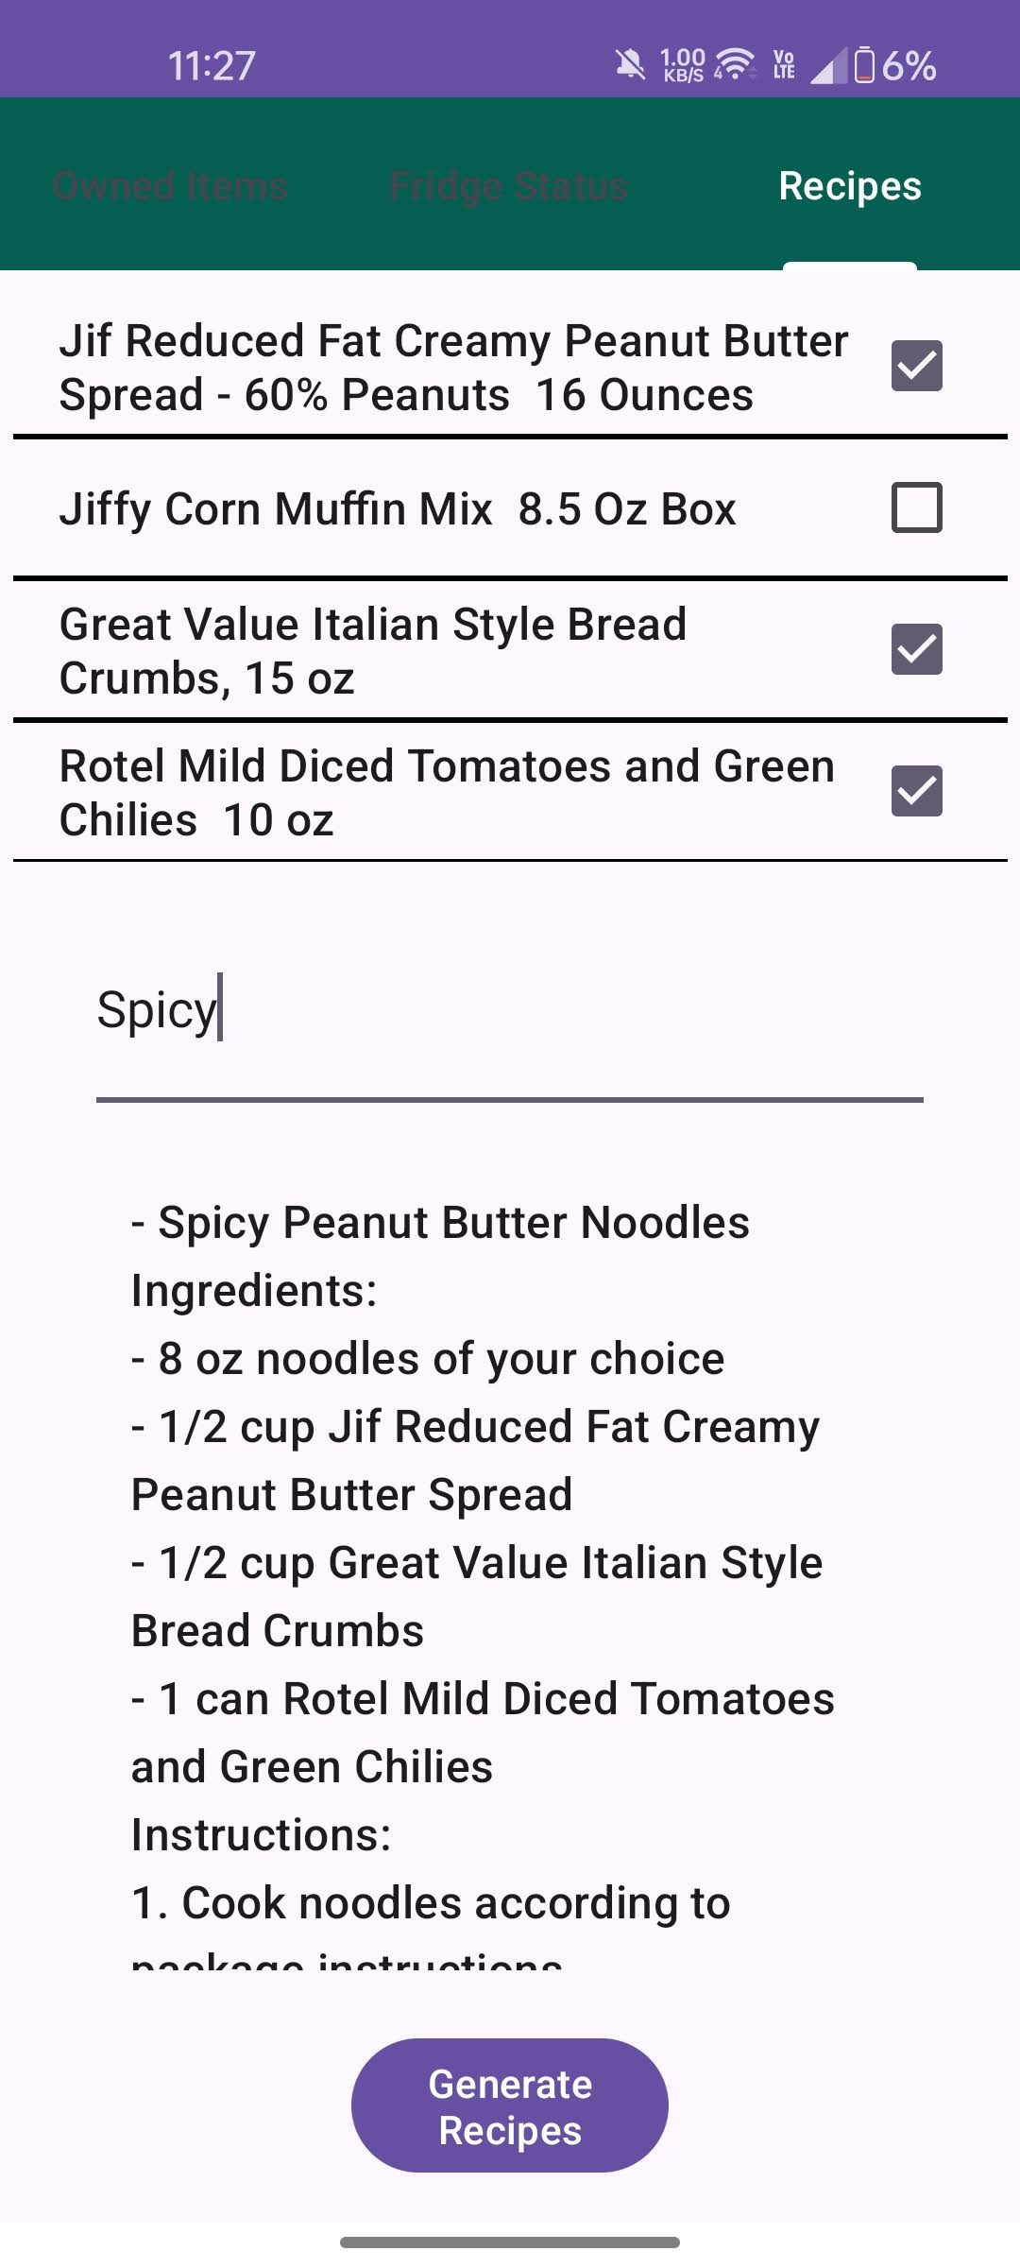
AI-Generated Recipes
Recipe hub allows for users to generate recipes based on selected items
User begins by selecting desired items to focus on in recipes
Optionally, a notes text field can help to add more details on what type of recipe is wanted
When “Generate Recipes” is tapped, request is made to OpenAI ChatGPT API with a specific prompt, to make recipes based on the ingredients
Response is parsed into a list of recipes that the user can scroll through and view

Slide 19
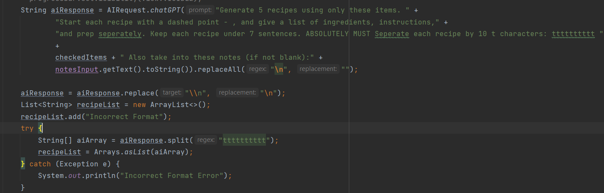
AI Prompt Used

Slide 20
Demo of Project, and Questions

Slide 21
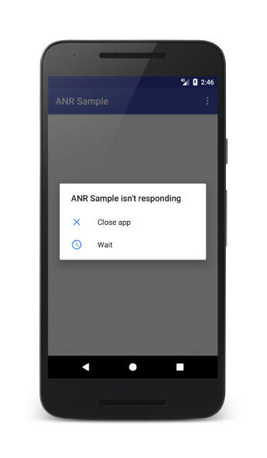
Challenges/Problems
ANRs while coding the app (App Not Responding)
If large requests are made on the main thread, app will crash
Android stops the app if no updates are made within 5 seconds
Learned tools to run heavy tasks (API requests) in the background
Usage of NFC tags
Complicated to use in Android apps, many informational sources are outdated and hard to follow.
More of a pain for users to add items
Sending Notifications
Test phone (OnePlus 9) was updated to Android 14
Google changed notification requirements for alarms, making it more difficult to send notifications in the background, when the app is closed

